Slide 1
Chapter 13
Implementing EC Systems:
From Justification to Successful Performance
CIS 579 – Technology of E-Business
Joseph H. Schuessler, PhD
Joseph.schuesslersounds.com
Tarleton State University
Stephenville, Texas
schuessler@tarleton.edu

Slide 2
Learning Objectives
Describe the major components of EC.
Describe the need for justifying EC investments.
Understand the difficulties in measuring and justifying EC investments.
Recognize the difficulties in establishing intangible metrics.
List and describe traditional and advanced methods of justifying EC investments.
Describe some examples of EC justification.
Describe the role of economics in EC evaluation.

Slide 3
Learning Objectives
Discuss the steps in developing an EC system.
Describe the major EC development strategies.
List the various EC development methods along with their benefits and limitations.
Discuss the major outsourcing strategies.
Describe the criteria used in selecting software vendors and packages.
Describe EC organizational structure, business process management, and change management.
Understand how product, industry seller, and buyer characteristics impact the success of EC.

Slide 4
The Implementation Landscape
THE MAJOR IMPLEMENTATION FACTORS
Justification/Economics
Acquire or Develop Your E-Commerce System
Organizational Readiness and Impacts of
E-Commerce
How to Succeed?

Slide 5
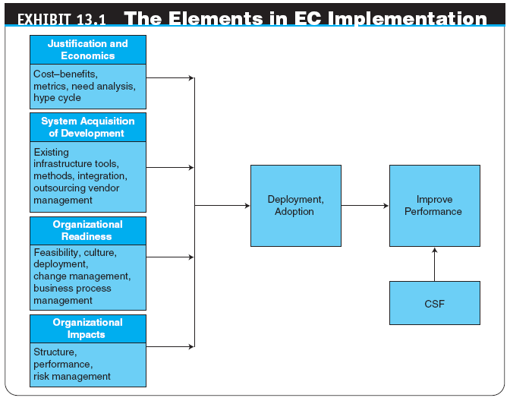

Slide 6
Why Justify E-Commerce Investments? How Can They Be Justified?
INCREASED PRESSURE FOR FINANCIAL JUSTIFICATION
OTHER REASONS WHY EC JUSTIFICATION IS NEEDED
EC INVESTMENT CATEGORIES AND BENEFITS

Slide 7
Why Justify E-Commerce Investments? How Can They Be Justified?
HOW IS AN EC INVESTMENT JUSTIFIED?
cost–benefit analysis
A comparison of the costs of a project against the benefits
Cost–Benefit Analysis and the Business Case
WHAT NEEDS TO BE JUSTIFIED? WHEN SHOULD JUSTIFICATION TAKE PLACE?

Slide 8
Why Justify E-Commerce Investments? How Can They Be Justified?
USING METRICS IN EC JUSTIFICATION
metric
A specific, measurable standard against which actual performance is compared
key performance indicators (KPIs)
The quantitative expression of critically important metrics

Slide 9
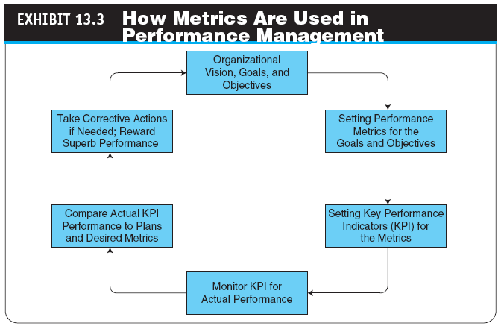

Slide 10
Why Justify E-Commerce Investments? How Can They Be Justified?
Web analytics
(1) The analysis of clickstream data to understand visitor behavior on a website
(2) The measurement, collection, analysis, and reporting of Internet data for the purposes of understanding and optimizing Web usage

Slide 11
Difficulties in Measuring and Justifying E-Commerce Investments
THE EC JUSTIFICATION PROCESS
DIFFICULTIES IN MEASURING PRODUCTIVITY AND PERFORMANCE GAINS
Data and Analysis Issues
EC Productivity Gains in One Area May Be Offset by Losses in Other Areas
Hidden Costs and Benefits
Incorrectly Defining What Is Measured
Other Difficulties

Slide 12
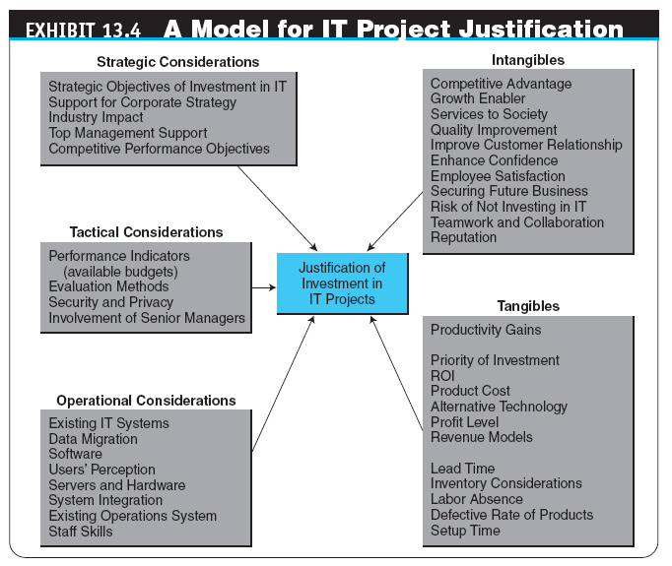

Slide 13
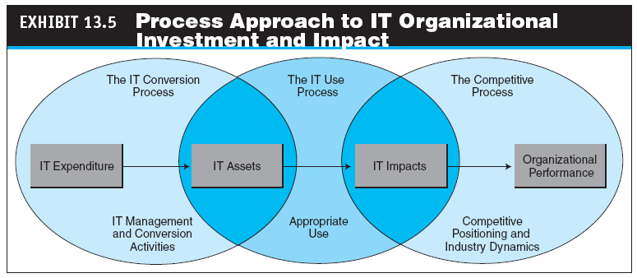

Slide 14
Difficulties in Measuring and Justifying E-Commerce Investments
INTANGIBLE COSTS AND BENEFITS
Tangible Costs and Benefits
These costs can be measured through accounting information systems.
Intangible Costs and Benefits
It is necessary to consider intangible benefits in a way that reflects their potential impact.
Handling Intangible Benefits
The first step in dealing with intangible benefits is to define them and, if possible, specify how they are going to be measured.

Slide 15
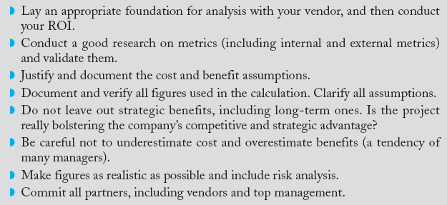
Difficulties in Measuring and Justifying E-Commerce Investments
THE PROCESS OF JUSTIFYING EC AND IT PROJECTS

Slide 16
Difficulties in Measuring and Justifying E-Commerce Investments
THE USE OF GARTNER’S HYPE CYCLE
hype cycle
A graphic representation of the maturity, adoption, and social application of specific IT tools

Slide 17
Difficulties in Measuring and Justifying E-Commerce Investments
Each hype cycle has five stages that reflect the basic adoption path any technology follows:
Technology trigger
Peak of inflated expectations
Trough of disillusionment
Slope of enlightenment
Plateau of productivity
Application of the Hype Cycle

Slide 18
Methods and Tools for Evaluating and Justifying E-Commerce Investments
OPPORTUNITIES AND REVENUE GENERATED BY EC INVESTMENT
METHODOLOGICAL ASPECTS OF JUSTIFYING EC INVESTMENTS
Types of Costs
Distinguish between initial (up-front) costs and operating costs
Direct and indirect shared costs
In-kind costs

Slide 19
Methods and Tools for Evaluating and Justifying E-Commerce Investments
TRADITIONAL METHODS FOR EVALUATING EC INVESTMENTS
The ROI Method
Payback Period
NPV Analysis
Internal Rate of Return (IRR)
Break-Even Analyses

Slide 20
Methods and Tools for Evaluating and Justifying E-Commerce Investments
total cost of ownership (TCO)
A formula for calculating the cost of owning, operating, and controlling an IT system
total benefits of ownership (TBO)
Benefits of ownership that include both tangible and intangible benefits
Economic Value Added
Using Several Traditional Methods for One Project
Business ROI Versus Technology ROI

Slide 21
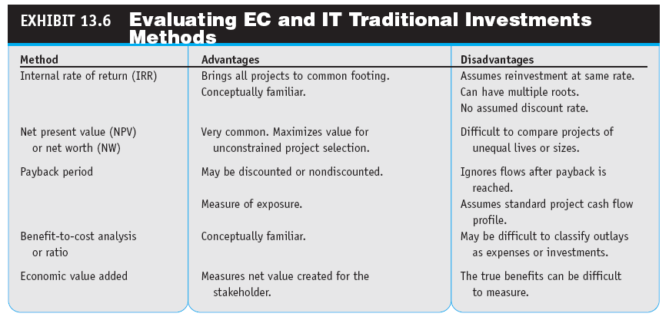

Slide 22
Methods and Tools for Evaluating and Justifying E-Commerce Investments
IMPLEMENTING TRADITIONAL METHODS
ROI calculator
Calculator that uses metrics and formulas to compute ROI
The Offerings from Baseline Magazine
Other Calculators

Slide 23
Methods and Tools for Evaluating and Justifying E-Commerce Investments
ADVANCED METHODS FOR EVALUATING IT AND EC INVESTMENTS
Financial approaches
Multicriteria approaches
Ratio approaches
Portfolio approaches

Slide 24
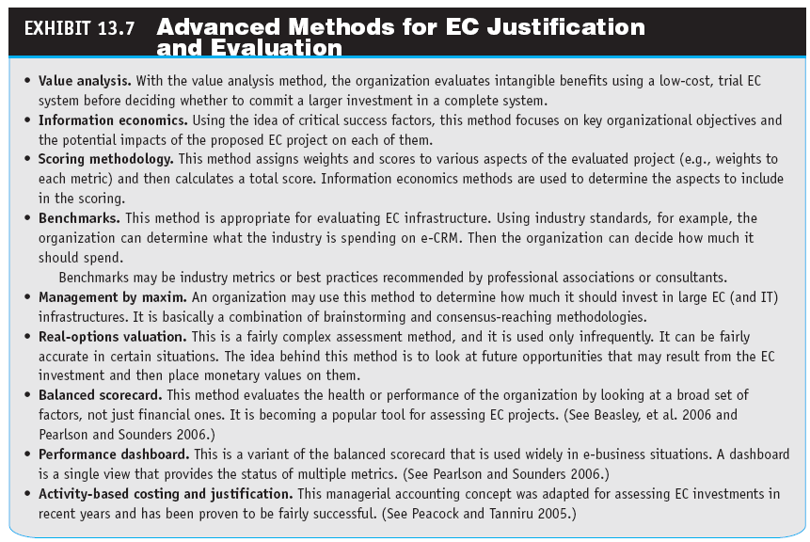

Slide 25
Examples of E-Commerce Metrics and Project Justification
JUSTIFYING E-PROCUREMENT
JUSTIFYING A PORTAL
JUSTIFYING SOCIAL NETWORKING AND THE USE OF WEB 2.0 TOOLS
JUSTIFYING AN INVESTMENT IN MOBILE COMPUTING AND IN RFID
JUSTIFYING SECURITY PROJECTS

Slide 26
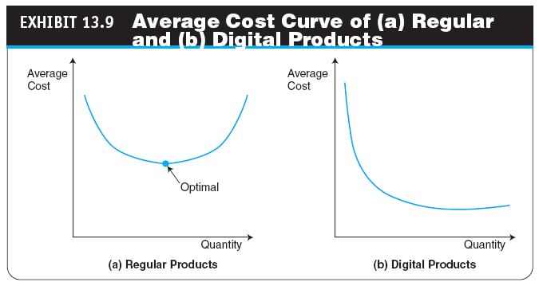
The Economics of E-Commerce
REDUCING PRODUCTION COSTS
Product Cost Curves

Slide 27
The Economics of E-Commerce
production function
An equation indicating that for the same quantity of production, Q, companies either can use a certain amount of labor or invest in more automation
agency costs
Costs incurred in ensuring that the agent performs tasks as expected (also called administrative costs)

Slide 28
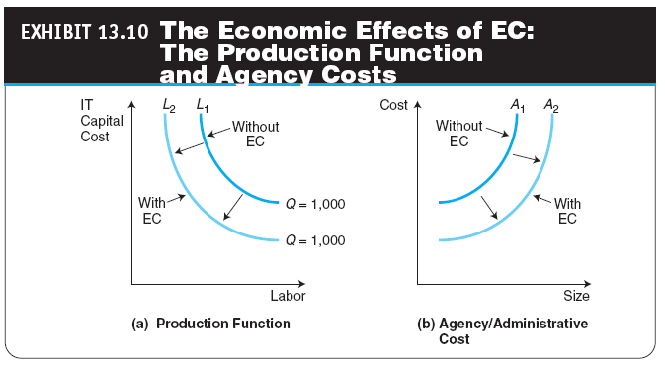

Slide 29
The Economics of E-Commerce
transaction costs
Costs that are associated with the distribution (sale) or exchange of products and services including the cost of searching for buyers and sellers, gathering information, negotiating, decision making, monitoring the exchange of goods, and legal fees

Slide 30
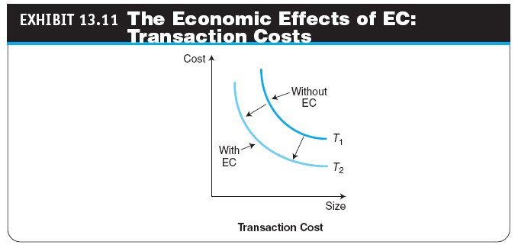

Slide 31
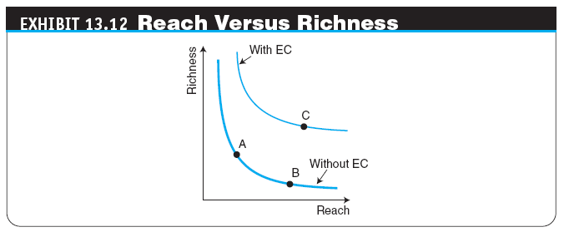
The Economics of E-Commerce
INCREASED REVENUES
Reach Versus Richness
Other Ways to Increase Revenues

Slide 32
The Economics of E-Commerce
REDUCING TRANSACTION FRICTION OR RISK
FACILITATING PRODUCT DIFFERENTIATION
product differentiation
Special features available in products that make them distinguishable from other products. This property attracts customers that appreciate what they consider an added value
EC INCREASES AGILITY
agility
An EC firm’s ability to capture, report, and quickly respond to changes happening in the marketplace and business environment

Slide 33
The Economics of E-Commerce
VALUATION OF EC COMPANIES
valuation
The fair market value of a business or the price at which a property would change hands between a willing buyer and a willing seller who are both informed and under no compulsion to act
For a publicly traded company, the value can be readily obtained by multiplying the selling price of the stock by the number of available shares.

Slide 34
A Five-Step Approach to Developing an E-Commerce System
Once it has been determined that a business can benefit from an online presence, the business type, the product line, the business’s organization, and the budget dictate what functionality the EC system should have and how the website should be developed.

Slide 35
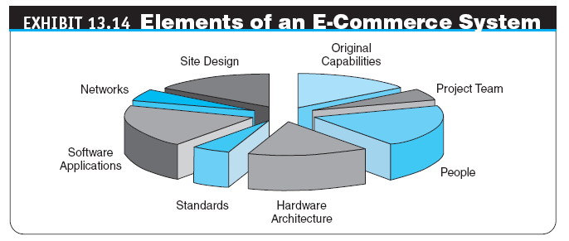

Slide 36
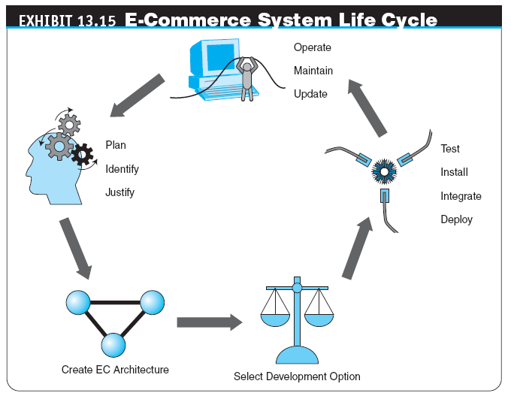

Slide 37
A Five-Step Approach to Developing an E-Commerce System
Identifying, justifying, and planning ec systems
Creating an EC architecture
Selecting a development option
Installing, testing, integrating, and deploying ec applications
Operations, maintenance, and updates

Slide 38
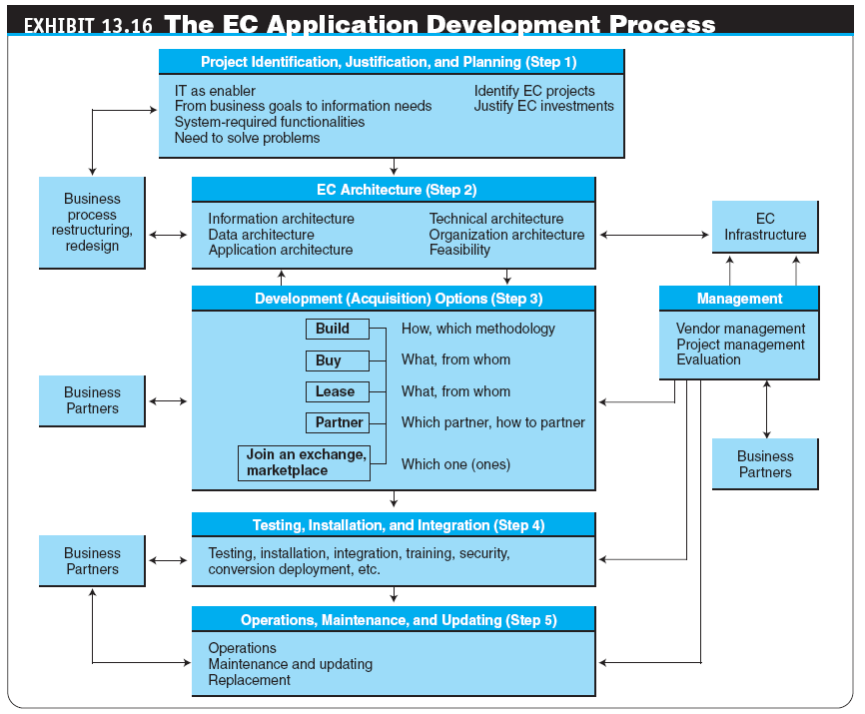

Slide 39
A Five-Step Approach to Developing an E-Commerce System
STEP 2: CREATING AN EC ARCHITECTURE
EC architecture
A plan for organizing the underlying infrastructure and applications of a site
STEP 3: SELECTING A DEVELOPMENT OPTION
STEP 4: INSTALLING, TESTING, INTEGRATING, AND DEPLOYING EC APPLICATIONS
unit testing
Testing application software modules one at a time
integration testing
Testing the combination of application modules acting in concert

Slide 40
A Five-Step Approach to Developing an E-Commerce System
usability testing
Testing the quality of the user’s experience when interacting with a website
acceptance testing
Determining whether a website meets the original business objectives and vision
STEP 5: OPERATIONS, MAINTENANCE, AND UPDATES
MANAGING THE DEVELOPMENT PROCESS

Slide 41
Development Strategies for E-Commerce Projects
Four basic options for developing an EC website:
Develop the site in-house either from scratch or with off-the-shelf components
Buy a packaged application designed for a particular type of EC site
Outsource system development
Lease the application

Slide 42
Development Strategies for E-Commerce Projects
IN-HOUSE DEVELOPMENT: INSOURCING
insourcing
In-house development of applications
reusability
The likelihood a segment of source code can be used again to add new functionalities with slight or no modification
interoperability
Connecting people, data, and diverse systems; the term can be defined in a technical way or in a broad way, taking into account social, political, and organizational factors

Slide 43
Development Strategies for E-Commerce Projects
BUY THE APPLICATIONS (OFF-THE-SHELF APPROACH)
turnkey approach
Ready to use without further assembly or testing; supplied in a state that is ready to turn on and operate
outsourcing
A method of transferring the management and/or day-to-day execution of an entire business function to a third-party service provider
Types of Outsourcing Options

Slide 44
Development Strategies for E-Commerce Projects
LEASING EC APPLICATIONS: CLOUD COMPUTING AND SOFTWARE-AS-A-SERVICE
cloud computing
The provision of computational resources on demand via a computer network; you pay only for actual usage
Software-as-a-Service (SaaS)
Advantages of Cloud Applications

Slide 45
Development Strategies for E-Commerce Projects
OTHER DEVELOPMENT OPTIONS
Join an e-marketplace
Join a consortium
Join an auction or reverse auction third-party site
Form joint ventures
Use a hybrid approach
SELECTING A DEVELOPMENT OPTION

Slide 46
Organizational Impacts of E-Commerce
IMPROVING MARKETING AND SALES
TRANSFORMING ORGANIZATIONS AND WORK
Technology and Organizational Learning
The Changing Nature of Work
Disintermediation and Reintermediation
disintermediation
Elimination of intermediaries between sellers and buyers

Slide 47
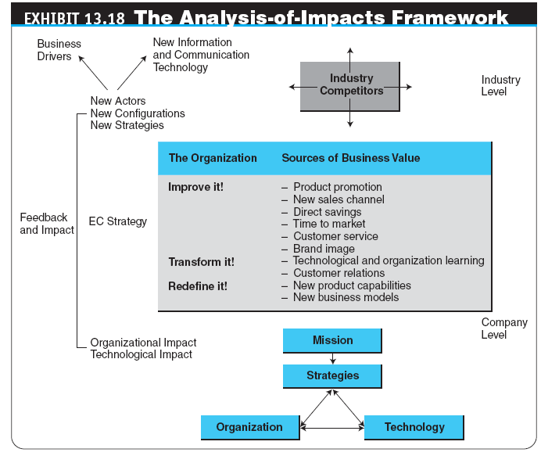

Slide 48
Organizational Impacts of E-Commerce
Restructuring Business Processes
business process reengineering (BPR)
A methodology for conducting a comprehensive redesign of an enterprise’s processes
business process management (BPM)
A holistic management approach focused on aligning all aspects of an organization with the wants and needs of clients; promotes business effectiveness and efficiency while striving for innovation, flexibility, and integration with technology

Slide 49
Organizational Impacts of E-Commerce
REDEFINING ORGANIZATIONS
New and Improved Product Capabilities
Personalization and Mass Customization
mass customization
A method that enables manufacturers to create specific products for each customer based on the customer’s exact needs
Impacts on Manufacturing

Slide 50
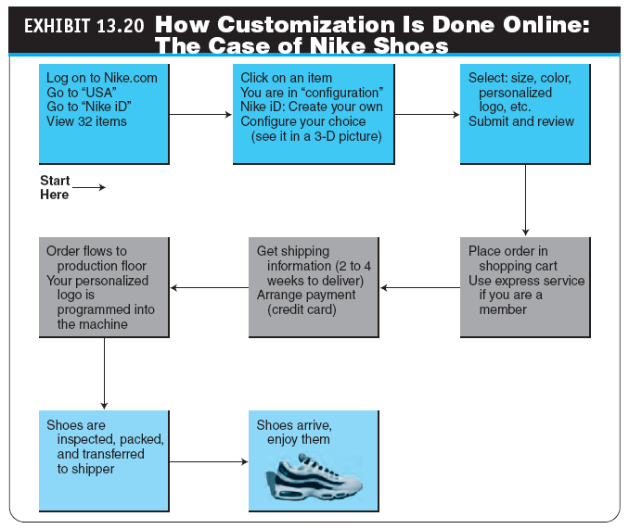

Slide 51
Organizational Impacts of E-Commerce
change management
A structured approach to shifting/transitioning individuals, teams, and organizations from a current state to a desired future state; it is an organizational process aimed at empowering employees to accept and embrace changes in their current business environment

Slide 52
Organizational Impacts of E-Commerce
HOW TO ORGANIZE AN EC UNIT IN A COMPANY
Options for Organizing the EC Workforce
Report to the Marketing Department
Report to the Finance Department
Report to the Chief Operating Officer
Distribute the EC Workforce in Several Departments
Report to the IT Department
Create a New, Autonomous EC Department
No Formal Structure for EC
Create an Autonomous Division or a Separate Online Company

Slide 53
Opportunities for Success in E-Commerce and Avoiding Failure
FACTORS THAT DETERMINE E-COMMERCE SUCCESS
E-Commerce Failures
E-COMMERCE SUCCESSES
Strategies for EC Success
CULTURAL DIFFERENCES IN EC SUCCESSES AND FAILURES
Can EC Succeed in Developing Economies?

Slide 54
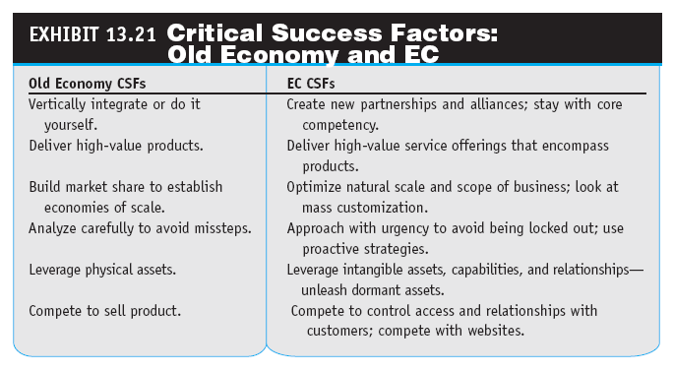

Slide 55
Managerial Issues
How should the value of EC investment be justified?
Which investment analysis method should we adopt for EC justification?
Who should conduct the justification?
Should we use the hype cycle?
What is the outsourcing strategy?
Should we embark on cloud computing products for our EC initiatives?
Which strategy should we choose for vendor selection: the inside-out or outside-in approach?
What kinds of organizational changes may be needed?
Is it possible to predict EC success?

Slide 56
Summary
The major components of EC implementation
The need for EC justification
The difficulties in justifying EC investment
Difficulties in established intangible metrics
Traditional methods for evaluating EC investments
Describe the justification of representative EC projects
EC economic evaluation

Slide 57
Summary
The major steps in developing an EC system.
The major EC development strategies, along with their advantages and disadvantages.
The varied EC application development methods, along with their benefits and limitations.
EC application outsourcing strategies.
Criteria used in selecting software vendors and packages.
The impact of e-markets on organizations.
Reasons for EC success and failure.

